Slide 1
Web Programming Project

Slide 2
CONTACT INFORMATION
Name : Eissa Abdellah Hadad
Section : 4
Depart: IS
Phone :01113741294
Email : eissa2020482@gamil.com

Slide 3
Descreption
The site will display game and reviews for each game
The site provides link to download the game
There will be part for the best games
To log in the site you should register by (email )

Slide 4
Client
.This site does not have any special people,
Every one interested in games specially youth people between 16:35 years

Slide 5
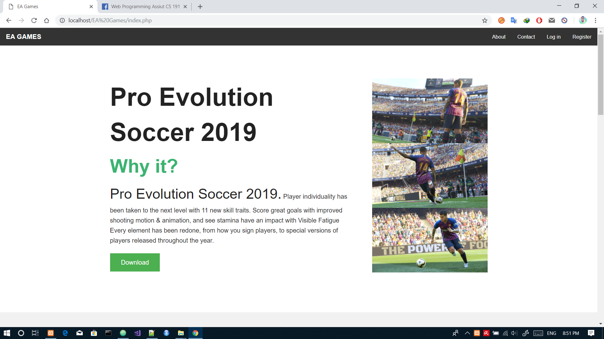
Example from the project

Slide 6
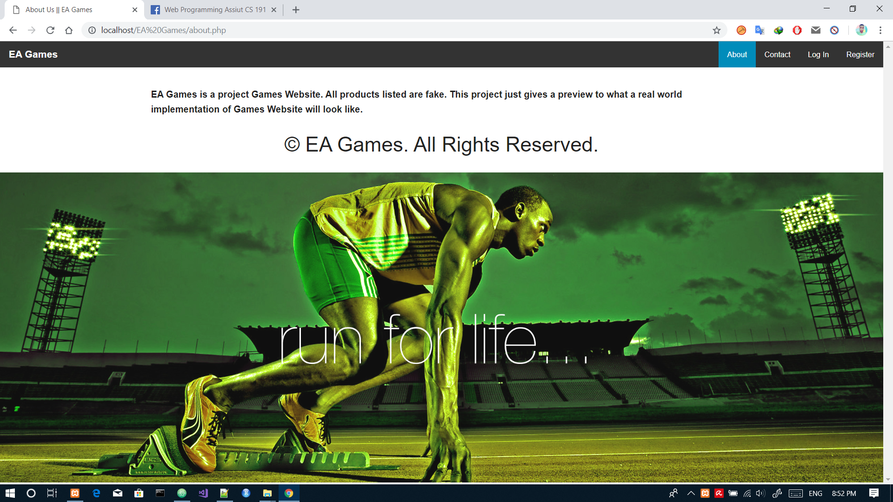
Example from the project

Slide 7
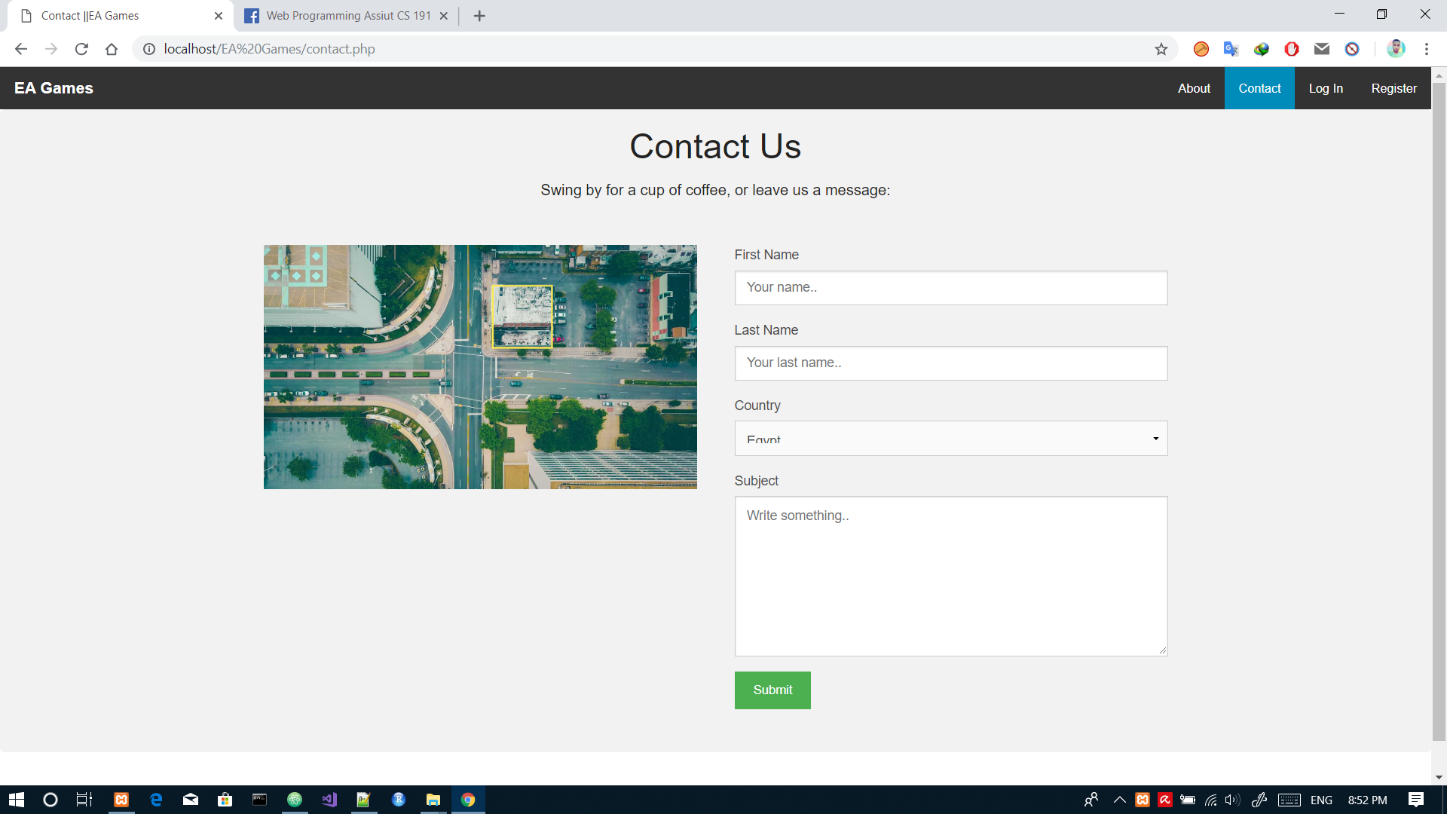
Example from the project

Slide 8
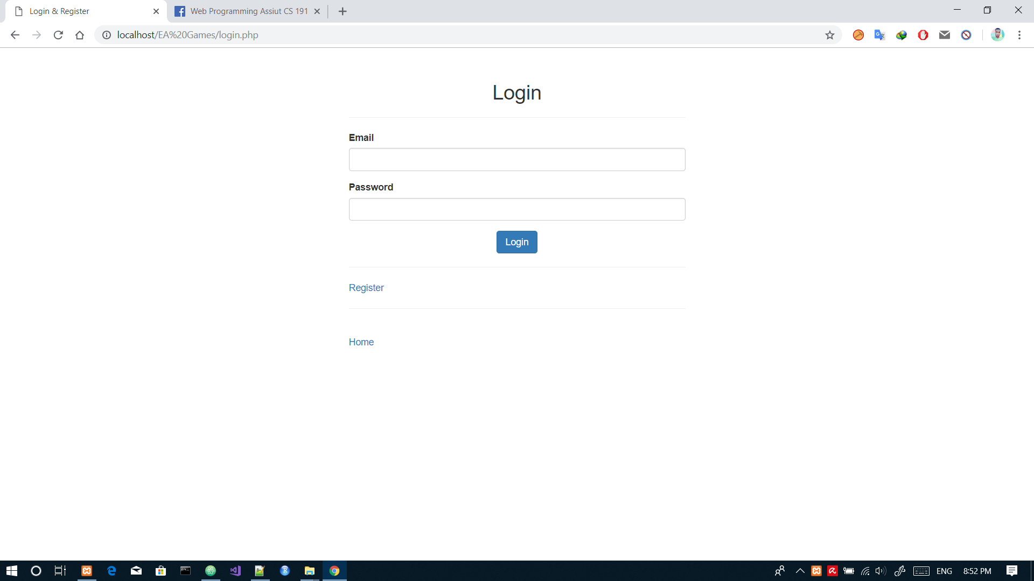
Example from the project

Slide 9
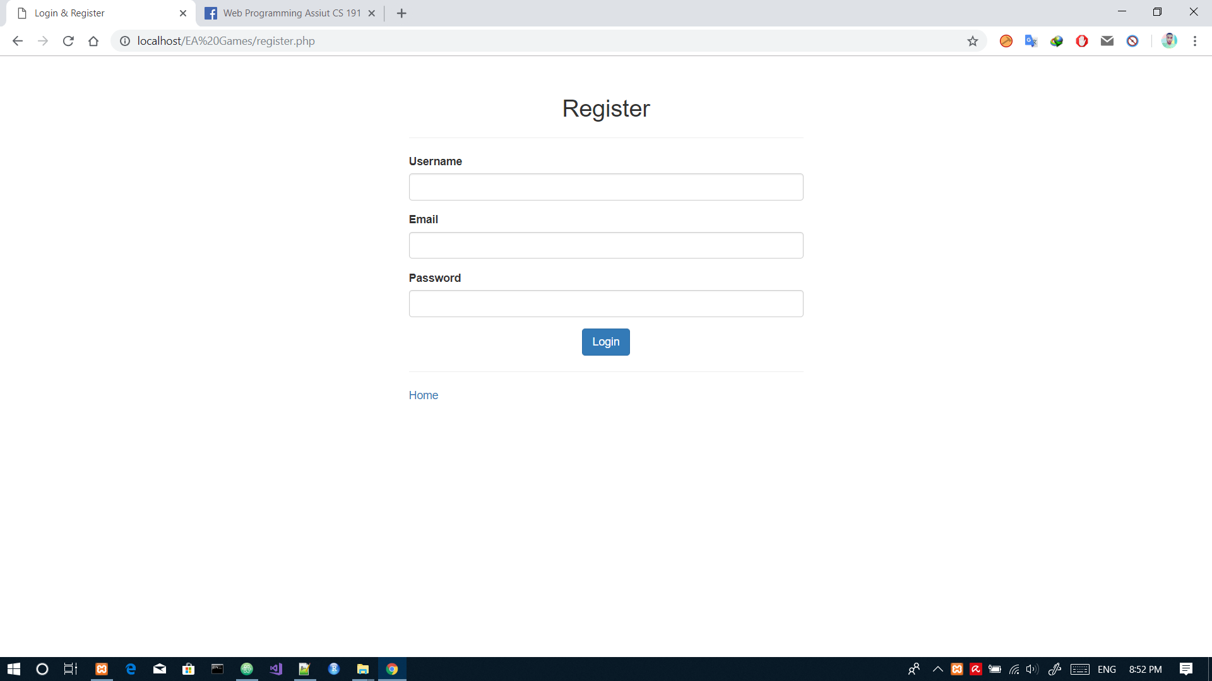
Example from the project

Slide 10
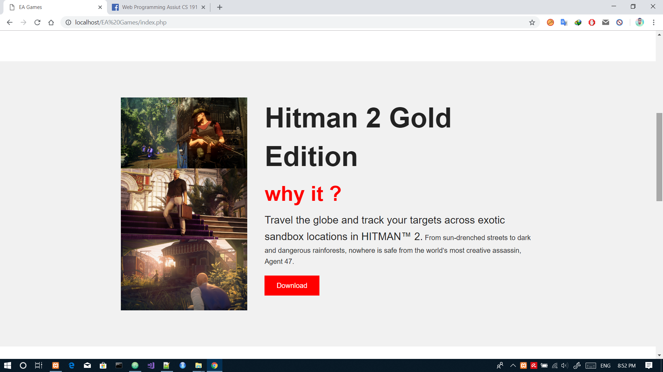
Example from the project

Slide 11
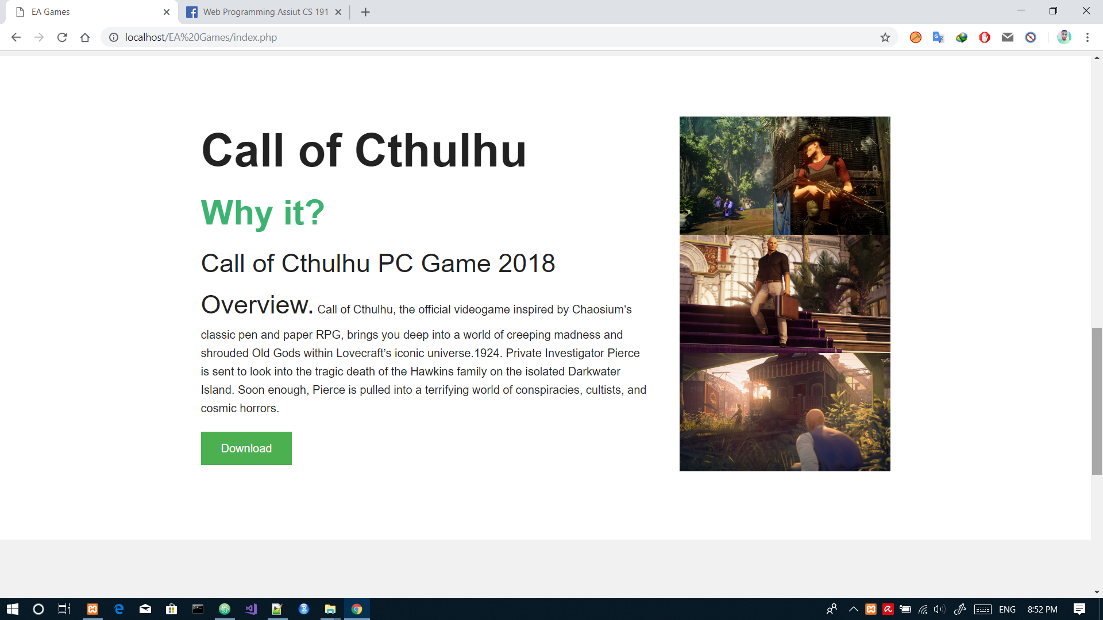
Example from the project

Slide 12
Techniques used
HTML
CSS
PHP
MYSQL

Slide 13
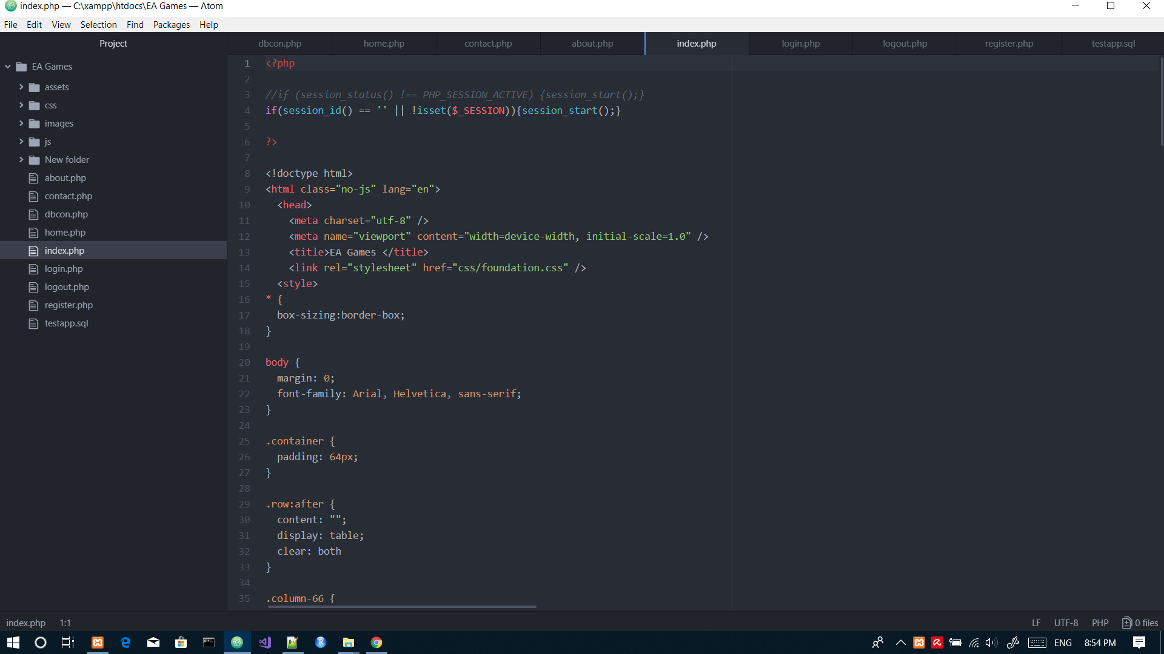
Html & php code

Slide 14
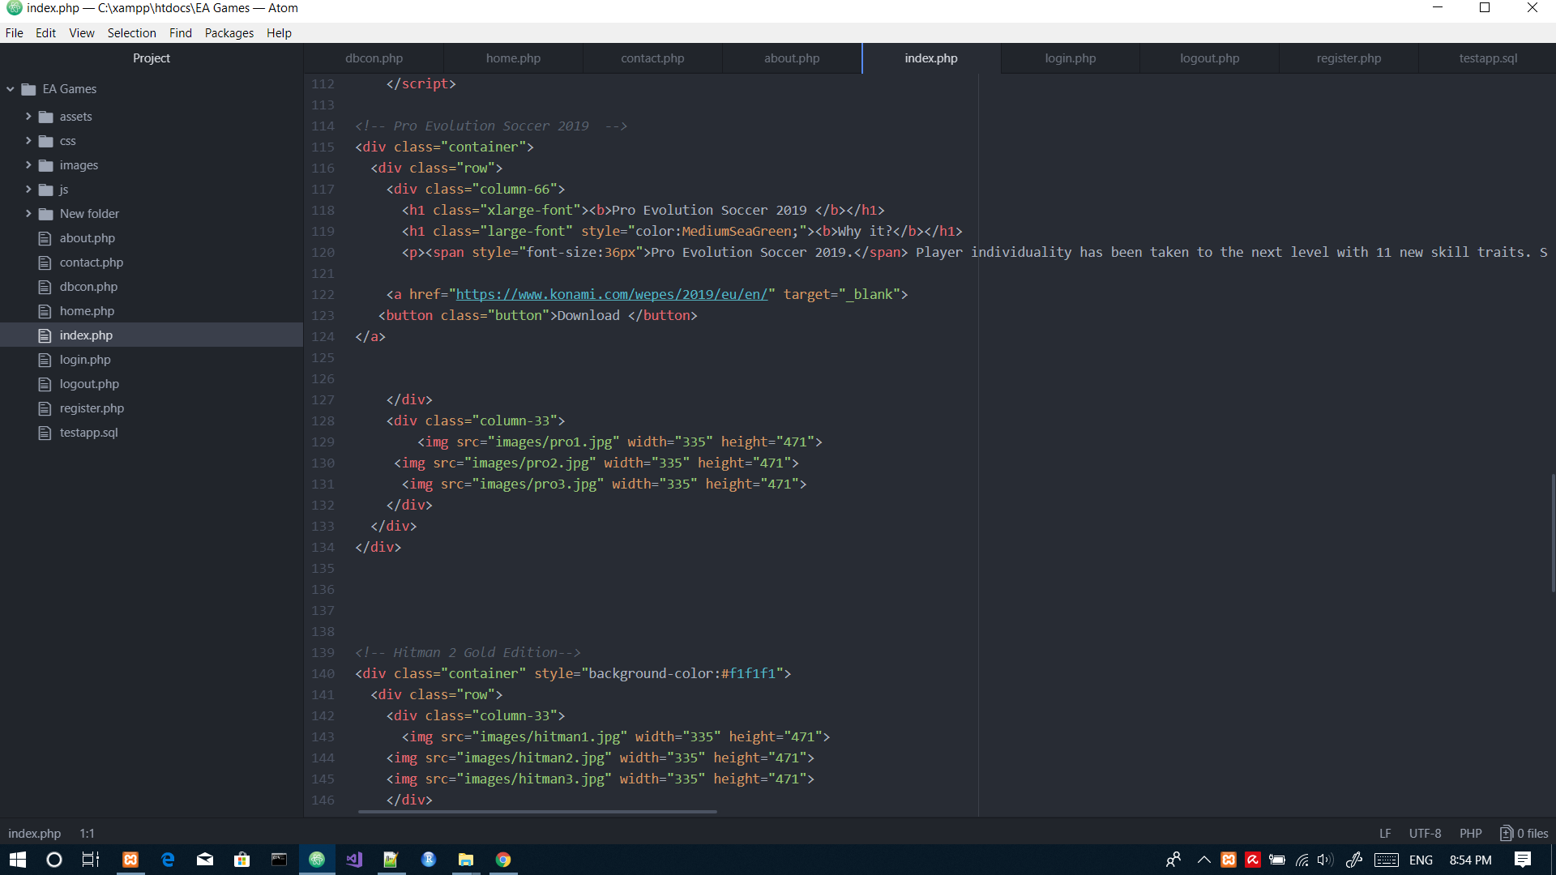
HTml & php code

Slide 15
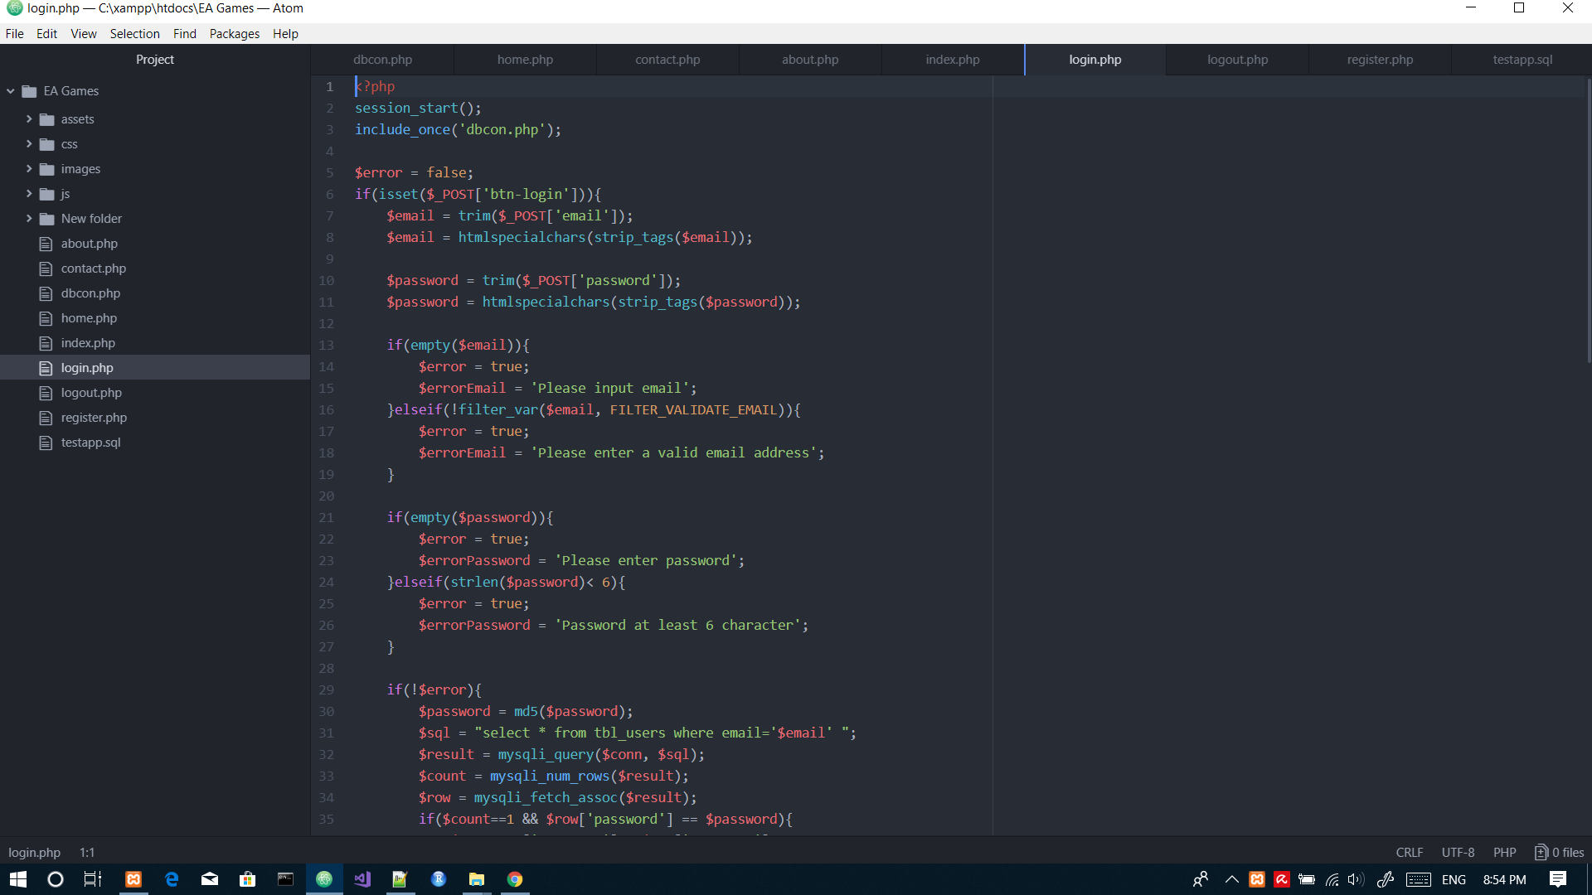
Php code

Slide 16
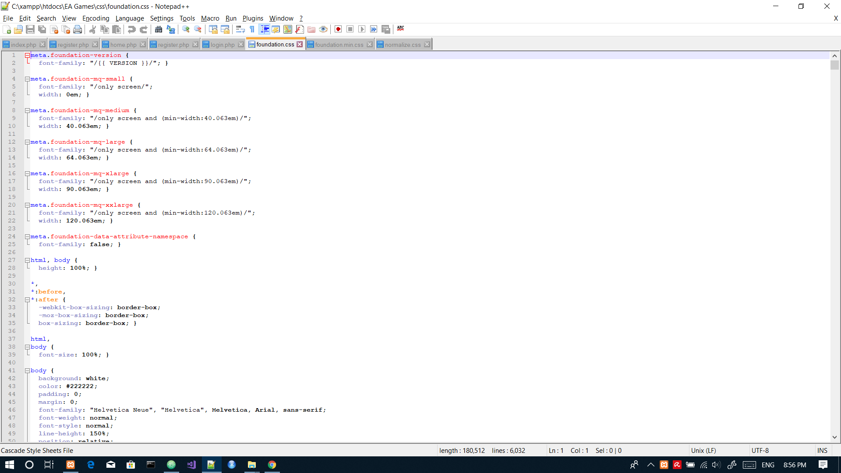
CSs code

Slide 17
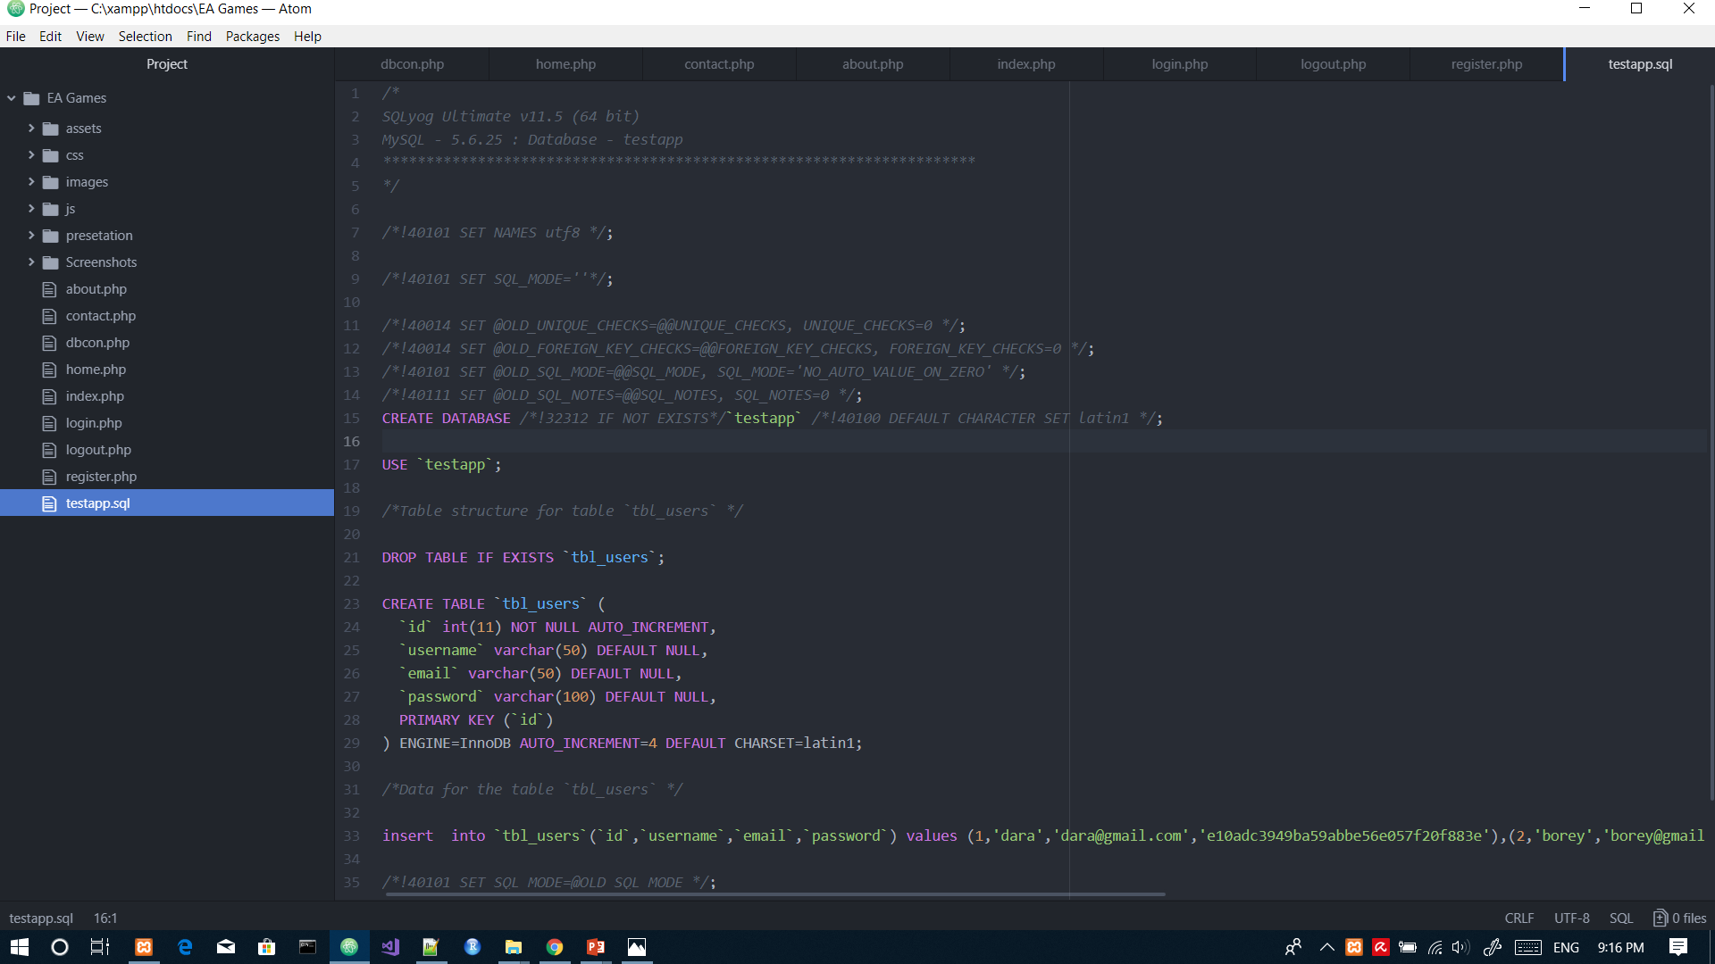
MYSQl

Slide 18
Link of the project on the github
https://github.com/EissaAbdellah/Web-Project.git

